Slide 1



RFID-Based Smart Access Control System with Intruder Detection and Automated Door Mechanism
Group No. 2
ATTANAYAKE A.M.S.P - EG/2021/4420 DAYANANDA G.G.A.I - EG/2021/4458
WICKRAMASINGHE B.G.D.D.A - EG/2021/4861

Slide 2

OBJECTIVES
To build an energy-efficient access monitoring system using RFID, activated by motion detection.
To design a microcontroller-based system that processes RFID data, manages access decisions and provide feedback via display and audio alerts
To implement user-friendly feedback with a motion sensor, LCD display, and buzzer for clear access indication.
To integrate a accelerometer and a gyroscope(mpu6050) for intruder detection, allowing immediate alerts for unauthorized forced entry.
To implement a servo motor to enable controlled door movement upon successful access.

Slide 3

AIMS
An energy-efficient RFID access monitoring system that activates only when needed, thanks to motion detection.
Clear visual and audio feedback to indicate access status using an LCD, LEDs, and a buzzer.
Enhanced security with forced entry detection and controlled door movement via a servo motor.
A user-friendly system that is easy to set up and suitable for various access monitoring applications.

Slide 4
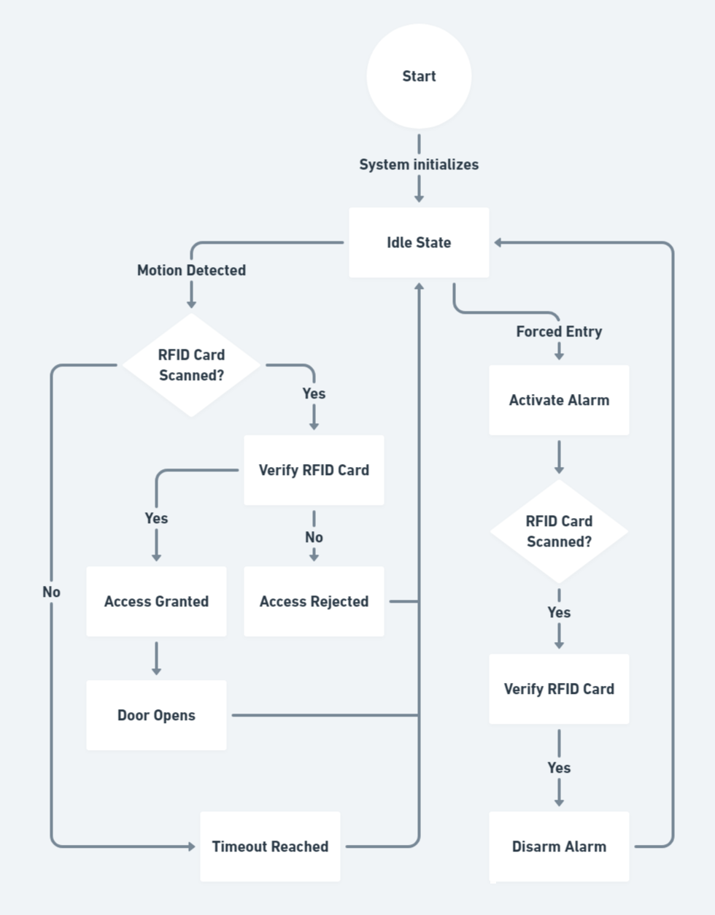

Slide 5
THANK YOU!

